Slide 1
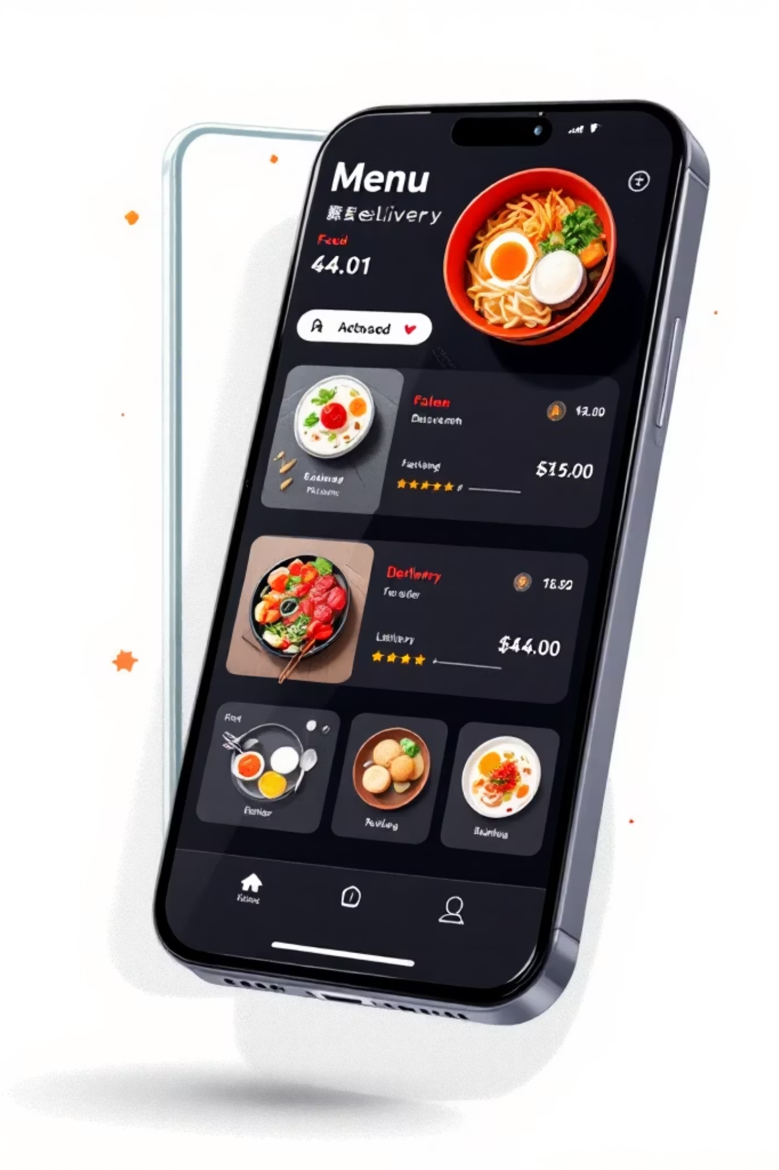
FoodieHub
An Online Food Ordering Platform
Industry-Oriented Hands-on Experience (CS253)
Presented by: Kausik Kumar Sahoo
University ID No.: 2211981197

Slide 2

Project Overview
FoodieHub is a centralized platform designed to create seamless interaction between customers and restaurants. The platform addresses inefficiencies in traditional food ordering systems, particularly the lack of real-time order tracking and fragmented user experiences.
This full-stack application connects diners with restaurants through an intuitive interface, enabling discovery, ordering, and tracking—all within a single unified system.

Slide 3

Project Objectives
User-Friendly Platform
Role-Based Access Control
Develop an intuitive interface that provides seamless navigation and exceptional user experience for both customers and restaurant owners
Implement secure authentication and authorization mechanisms to distinguish between customer and restaurant owner functionalities
Real-Time Tracking
System Scalability
Enable live order status updates, allowing customers to monitor their orders from preparation to delivery
Build a scalable architecture capable of handling increased traffic and expanding restaurant partnerships efficiently

Slide 4
Technical Stack
1
2
Frontend Architecture
Backend Services
React.js with Vite for fast development and hot module replacement
Node.js runtime for server-side execution
Express.js framework for building RESTful APIs
Tailwind CSS for utility-first styling and responsive design
3
4
Database Layer
Authentication & Deployment
MongoDB NoSQL database for flexible data storage
Clerk Authentication for secure user management
Mongoose ODM for schema modeling and data validation
Vercel for frontend hosting and CDN distribution

Slide 5
Functional Requirements
User Registration & Authentication
Menu Management System
Secure user registration with email verification
Role-based account creation (Customer or Restaurant Owner)
Password recovery and account management features
Restaurant owners can add, update, and remove menu items
Category organization and item categorization
Image upload and pricing management
Role-Based Access Control
Order Tracking Dashboard
Customer dashboard for browsing and ordering
Restaurant owner portal for menu and order management
Distinct permissions and interface for each role
Real-time order status updates for customers
Order history and transaction records
Delivery status visualization

Slide 6





System Architecture
Authentication Module
Handles user registration, login, session management, and secure token-based authentication using Clerk
Menu Management
CRUD operations for menu items, categories, and restaurant information with data validation
Order Module
Order processing, cart management, payment integration, and status tracking system
Analytics Dashboard
Restaurant owners can view sales reports, customer insights, and performance metrics

Slide 7
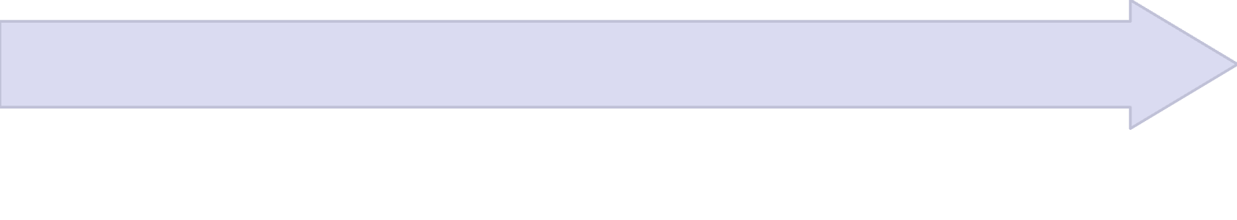
User Workflow
Browse Restaurants & Menu
User Login / Registration
Customers explore available restaurants, filter by cuisine or location, and view detailed menu items with descriptions and prices
Users authenticate using secure credentials and are redirected to their personalized dashboard based on assigned role
Place Order & Track
Add Items to Cart
Complete payment process and monitor real-time order status updates from preparation to delivery completion
Select menu items, customize orders, and add them to the shopping cart for checkout

Slide 8
Testing & Feasibility Analysis
Test Cases Implemented
Feasibility Assessment
Login Validation
Technical Feasibility
Tested credential verification, error handling for invalid inputs, and session management
Confirmed all technologies integrate seamlessly with existing infrastructure and documentation support
Form Handling
Economic Feasibility
Validated form submissions, input sanitization, and error message displays
Evaluated cost-effectiveness using modern stack with free-tier services and scalable pricing models
CRUD Operations
Operational Feasibility
Verified create, read, update, and delete functionality for menu and order management
Verified user-friendly interface and intuitive workflows meet operational requirements

Slide 9
Key Takeaways
Full Stack Development Expertise
REST API Development
End-to-End Deployment
Mastered creating RESTful endpoints, request handling, response formatting, and implementing proper HTTP status codes and error handling
Successfully deployed complete application to production environment, managing configuration, environment variables, and domain setup
Gained comprehensive skills in building end-to-end applications from frontend interfaces to backend services and database management

Slide 10

Project Conclusion
FoodieHub demonstrates the complete development lifecycle of a modern web application, from initial concept to production deployment. The platform successfully addresses real-world challenges in food ordering systems while providing valuable learning experiences in full-stack development, API design, and system architecture.
This project showcases practical application of modern web technologies and software engineering principles, preparing for industry challenges while delivering a functional, scalable solution.
Thank you for your attention. Questions and feedback are welcome.

